Slide 1

Retail Store Analysis
By- Aditya Warungase

Slide 2


About Me
ADITYA Warungase
Bachelor of Engineering in Artificial Intelligence and Data Science
I am passionate about Data Science, as I enjoy working with data, uncovering insights, and transforming information into meaningful solutions.
I love exploring new technologies, solving real-world problems, and continuously improving my technical skills
My goal is to make data tell impactful stories that drive smart decisions.
Linkedln | GitHub

Slide 3
Index
1. | Business Objective
2. | Entity relationship diagram (ERD)
3. | SQL Queries and Results
4. | Final Business Insights
5. | My Experience / Challenges
6. | Conclusion

Slide 4
Business Objective
The objective of this project is to analyze a real-world retail dataset using SQL to derive meaningful business insights.
The project focuses on understanding customer behavior, order and delivery performance, product and category trends, payment patterns, review sentiments, and seller/location performance.
By applying SQL concepts such as joins, aggregations, subqueries, and window functions, the project aims to support data-driven decision-making and demonstrate practical data analysis skills in a retail business context

Slide 5
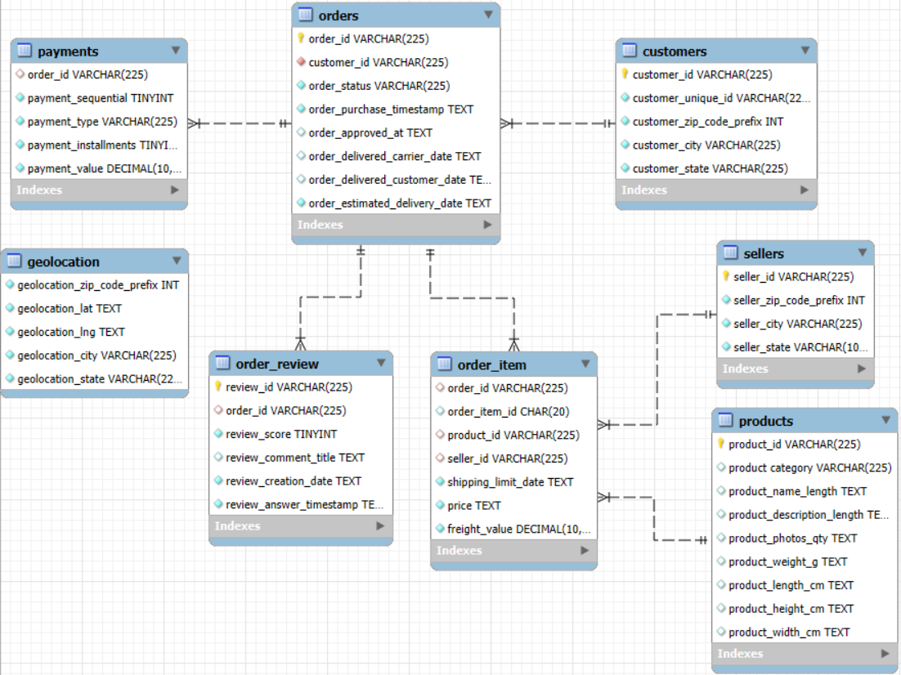
ER Diagram

Slide 6
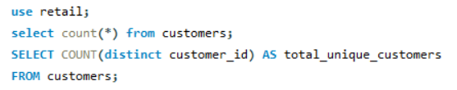

Customer Analysis
Find the total number of unique customers

Slide 7
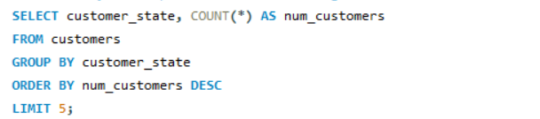
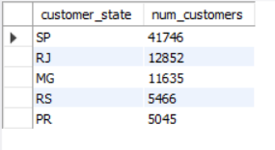
Identify the top 5 states with the highest number of customers

Slide 8
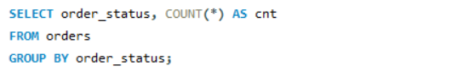
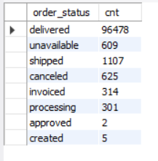
Order & Delivery Analysis
Count the total number of delivered vs canceled orders

Slide 9
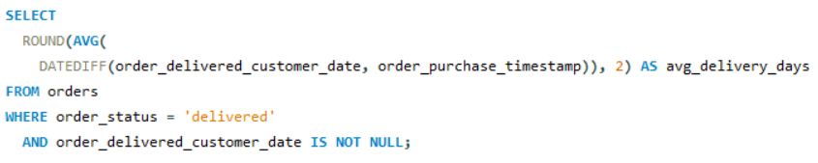

Calculate the average delivery time for delivered orders

Slide 10
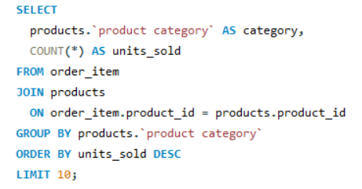
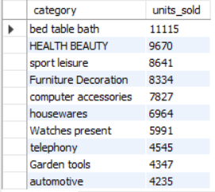
Product & Category Analysis
Find the top most sold product categories

Slide 11
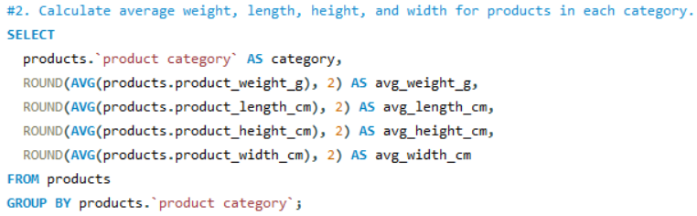
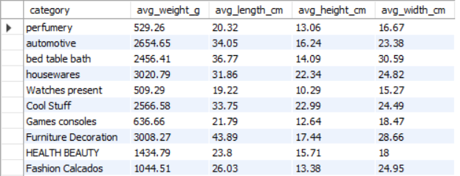
Calculate average weight , length, height, and width for products in each category

Slide 12
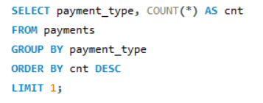
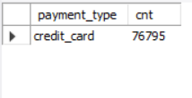
Payment & Revenue Analysis
Find the most common payment type

Slide 13
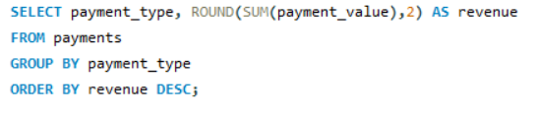
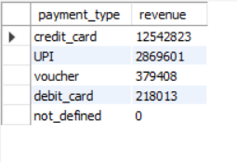
Calculate revenue by payment type

Slide 14
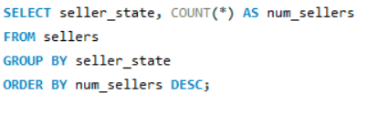
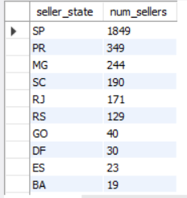
Seller & Location Analysis
Count the number of sellers per state

Slide 15
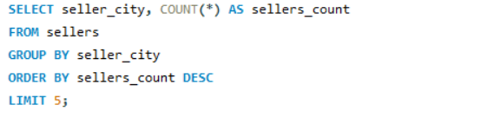
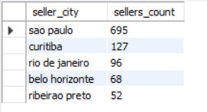
Identify the top 5 cities with highest seller density

Slide 16
Insights
The total number of unique customers on the platform is 99,441, with the highest customer concentration in the states of SP, RJ, MG, RS, and PR.
A majority of orders are successfully completed, with 96,478 delivered orders compared to only 625 canceled orders.
The average delivery time for delivered orders is 12.5 days, highlighting the role of efficient logistics in customer satisfaction.
The most sold product categories include bed table bath, health beauty, sports leisure, furniture decoration, computer accessories, and housewares.
Product dimension analysis helped in understanding variations in weight, length, height, and width across categories, supporting better inventory and shipping planning.
Credit cards are the most commonly used payment method and also contribute the highest share of total revenue.

Slide 17
Challenges
Understanding and working with a large relational dataset containing multiple tables and complex relationships.
Handling data type issues, such as numeric values stored as text, which required casting and data cleaning.
Writing correct JOINs to avoid duplicate records and ensure accurate results.
Managing date and time calculations for delivery and order analysis.
Ensuring queries were simple, optimized, and error-free while meeting assignment requirements.
Interpreting SQL results and converting them into meaningful business insights for presentation.

Slide 18
Conclusion
The analysis shows that while the platform has a strong customer base, repeat purchases are limited, indicating the need for better retention strategies. Delivery speed significantly affects customer satisfaction, with faster deliveries receiving better reviews. A few product categories and sellers contribute most of the sales and revenue, while credit cards remain the preferred payment method. Overall, improving logistics efficiency, customer retention, and seller performance can drive higher satisfaction and sustainable business growth.

Slide 19

THANK YOU

